Slide 1
Engineering Chemistry
HIGHER TECHNOLOGICAL INSTITUTE - 10th of Ramadan City
CHEMICAL ENGINEERING DEPARTMENT
CHM 001

Slide 2
CHAPTER 7
CEMENT
SOAP DETERGENTS

Slide 3
CEMENT INDUSTRY
Cement is a fine grey powder which when reacted with water hardens to form a rigid chemical mineral structure which gives concrete its high strengths.
The most common type of cement is the Ordinary Portland Cement (OPC), which has been defined as the product obtained by pulverizing the sintered mass known as clinker consisting essentially of calcium silicates.

Slide 4
Cement is an important building material and is applied everywhere in the construction of homes, public buildings, roads, industrial plants, dams, tunnels and many other structures

Slide 5
Types of materials necessary for the production of Portland cement
Materials rich in calcium such as lime stone [ CaCO3]
Materials rich in silica such as clay [ Al2O3.2SiO2.2H2O]
Wastes of [MgCO3+SiO2+Fe2O3]

Slide 6
Manufacturing Process
There are two types of processes that can be used to manufacture Portland Cement according as to whether the raw materials are ground in wet or dry state
Dry Process
Wet Process
The selection of suitable process depends upon certain factors which include
Overall techno- economic feasibility
Suitability of raw materials for the particular process
Availability and cost of utilities

Slide 7
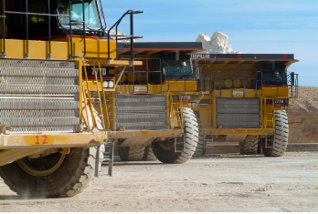
Manufacturing Process
Step 1: Mining
The cement manufacturing process starts from the mining of raw materials that are used in cement manufacturing, mainly limestone and clays.

Slide 8
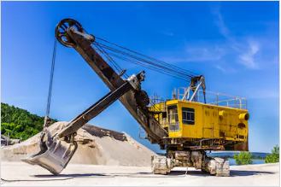
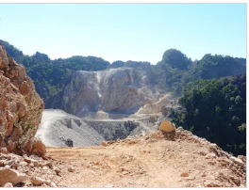
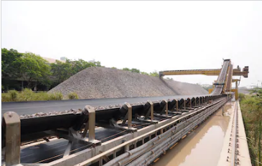
The limestone is excavated from open cast mines after drilling and blasting and loaded onto dumpers which transport the materials and unload into hoppers of limestone crushers
Excavator for mining of Limestone
Limestone mining,
Open pit mine
Limestone mining and transportation

Slide 9
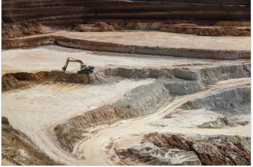
The clays are excavated from open cast mines and loaded onto dumpers which transport the materials and unload into open yard storage. Then it is transported by trucks and unloaded into the hopper of a clay crusher.

Slide 10
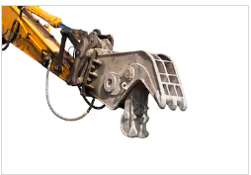
Step 2: Crushing of raw materials
The limestone is crushed in
the first crusher called a
jaw crusher
It is then fed into the
second crusher called an impact crusher with mixing of clays
to reduce particle size below 50mm.
The discharged raw mix (limestone 70%, clays 30%) is fed onto a belt conveyor
The raw mix is fed into a circular storage unit called a raw mix storage.

Slide 11
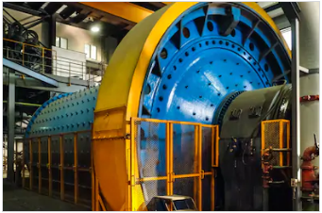
Step 3: Raw meal grinding and mixing
The crushed materials are again grinded to get fine particles into ball mill or tube mills
Each finely grinded material
is stored in hopper after screening
Now these powdered materials are mixed in required proportion to get dry raw mix
The raw mix is then stored in silos and kept ready to be sent into rotary kiln

Slide 12
Step 4: Clinkerization in the Rotary Kiln
The raw mix is then burnt in rotary kilns to form hard granular sintered masses called clinker which contains the following compounds

Slide 13
The basic chemistry of the cement manufacturing process
Calcination process begins with the decomposition of calcium carbonate (CaCO3) at about 900 °C to leave calcium oxide (CaO, lime) and liberate gaseous carbon dioxide (CO2)
Clinkering process in which the CaO reacts at high temperature (typically 1400-1500 °C) with silica, alumina, and ferrous oxide to form the silicates, aluminates, and ferrites of calcium which comprise the Clinker(C3A, C4AF, C2S, C3S).
Cement production in which the clinker is ground or milled together with gypsum to produce cement.

Slide 14
In both wet and dry processes the 3 distinct operations of :
Mixing, Ball mill
Burning, Rotary kiln
Grinding
are carried out.

Slide 15
Cement Clinker is Manufactured by : 1. Wet Process [use water in production]
Mixing
The crushed raw materials in desired proportions are fed into ball mills
A 35 -40% water to is added to it to form a slurry.
This slurry is then passed into storage tanks known as silos where their proportioning is finally adjusted to ensure the correct chemical composition.
Corrected slurry is then fed into the rotary kiln for burning

Slide 16
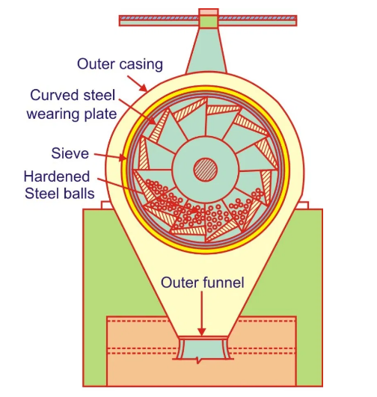
Ball mill is a rotating steel cylinder in which there are hardened steel balls. When the mill rotates, the steel balls pulverize the raw materials which forms into a solution with water. This liquid mixture is known as slurry
Composition of raw mix can be controlled better by the wet process than in dry process.

Slide 17
(ii) Burning
Corrected slurry is fed at the higher end of the inclined rotary kiln whereas from the lower end of the kiln flame is produced by injecting pulverized coal with a blast of air.
Slurry on entering the furnace losses moisture and forms into small lumps or “nodules”.
The nodules gradually roll down passing through zones of rising temperature until they reach burning zone where they are finally burnt at 1500 to 1650ºC.
At this temperature “nodules” change to Clinkers (40-10 mm).
Clinkers are air-cooled in another inclined tube similar to the kiln but of lesser length.

Slide 18
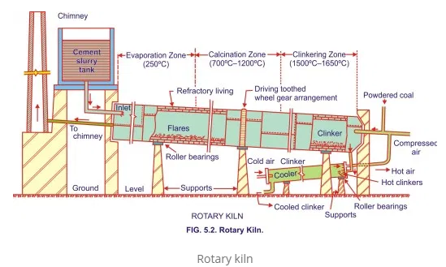
Rotary kiln is a steel tube lined inside with free bricks. It is 90 to 120 metres long and from 2.5 to 3.5 meters in diameter. The kiln is mounted on rollers at a gradient of 1 in 25 to 1 in 30 and rotating once in every minute.

Slide 19
(iii) Grinding
Hot clinker discharge from the kiln drops onto the grate cooler for cooling from approximately 1350-1450 °C to approximately 120 °C.
Grinding of the Clinker is done in large tube mills which are kept cool by spraying water on them from outside.
While grinding the clinker 3- 4 % gypsum (Calcium sulphate) is added so as to control the setting time of cement.
The gypsum acts as a retarder and it delays the setting action of cement.
Finely ground cement is stored in silos from where it is drawn for packing.

Slide 20
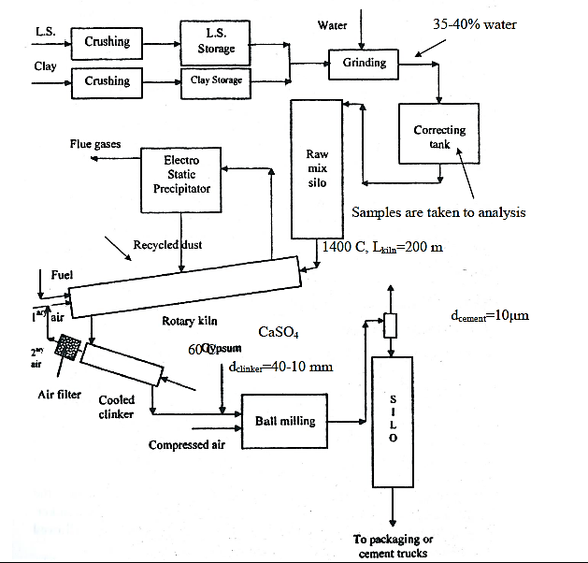
Production of OPC by Wet Process

Slide 21
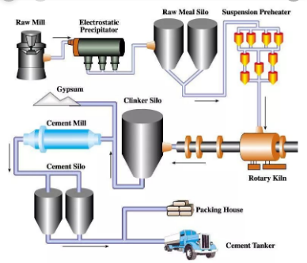
Wet Process
Advantages: required for specific types of cement due to high homogenous in raw material mixture
Disadvantages: very tall kilns, high required energy

Slide 22
Cement Clinker is Manufactured by : 2. Dry Process
In this process :
1. lime stone and clay are ground separately to tine powders and are then mixed together in the desired proportions.
2. Water is then added to it so as to get a thick paste of which cakes are then made, dried and burnt in kilns.
3. To the clinker obtained after burning, is added three to four per cent of gypsum and ground to very fine powder. This powder is cement ready for use.

Slide 23
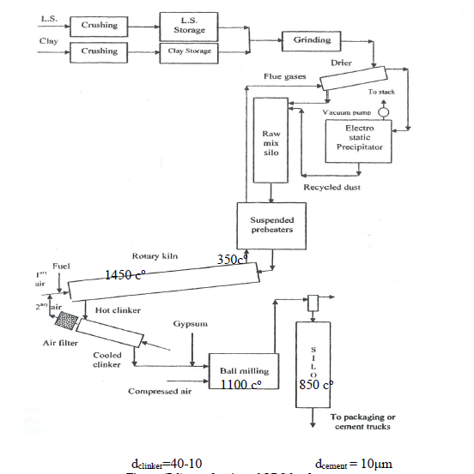
Production of OPC by Dry Process

Slide 24
Disadvantages of Dry Process
This process is slow and costly. Also it is difficult to have the correct proportion of constituents. The quality of cement is not so good as that of the one manufactured by the Wet process.

Slide 25
Advantages of Dry Process
shorter kilns (45 m), saving heat energy, more than 90% of cement production in Egypt is made through dry process.

Slide 26
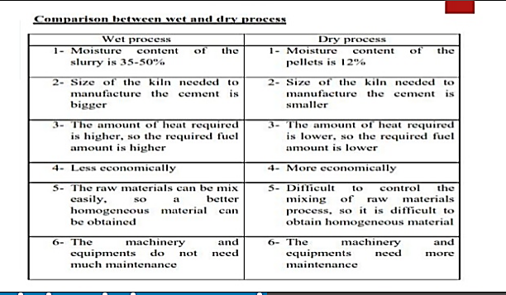

Slide 27
Some facts about the two processes
The fuel consumption in the wet process is rather high (1350 - 1500 kcal/kg clinker), but the electrical energy consumption (in kWh/t) is less compared to dry grinding.
Wet process consumes less power during grinding. Dry process requires approximately 30 % more power.
Proportioning of dry raw meal to required composition is easier than doing the same for moist, wet or plastic cake

Slide 28
Quality of clinker in wet process is better due to better homogenization achieved in slurry raw meal, but now, by pneumatic blending, dry raw meal is also homogenized to the same degree.
Wet process plant requires 20 % more silo volume for slurry storage.
The wet process is rarely used these days and the shift is towards dry process.

Slide 29
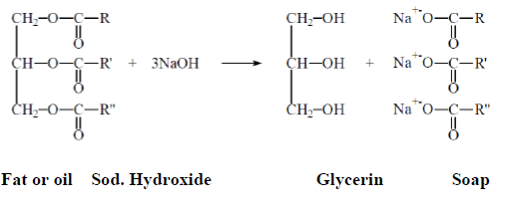
Soap Industry
Soap is widely used in our society. Soaps are the product of the reaction between a fat and sodium hydroxide:
Fat +3 NaOH → Glycerin + 3 Soap

Slide 30
Soap is Produced Industrially in Four Basic Steps
Step 1 – Saponification
Fat and sodium hydroxide are mixed and heated. The soap produced is the salt of a long chain carboxylic acid
Step 2 - Glycerin removal
Glycerin is more valuable than soap, so most of it is removed. Some is left in the soap to make it soft and smooth. Soap is not very soluble in salt water, whereas glycerin is, so salt is added to the wet soap causing it to separate out into soap and glycerin in saltwater.

Slide 31
Step 3 - Soap neutralization & drying
Any remaining sodium hydroxide is neutralized with a weak acid such as citric acid and two thirds of the remaining water removed
Step 4 – Finishing
Additives such as preservatives, color and perfume are added and mixed in with the soap and it is shaped into bars for sale.

Slide 32
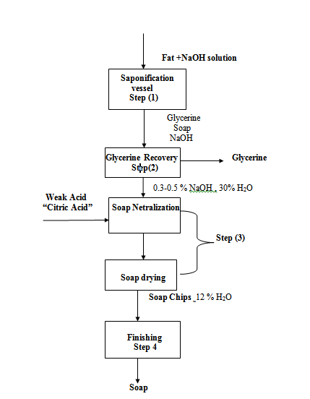

Slide 33
Detergent Industry
A detergent is synthetic surfactants. They are made both in powder and liquid form. These substances are usually alkyl benzene sulfonates

Slide 34
Powder Detergents Production
Step1
All ingredients are first combined into slurry in a tank heated and then pumped to the top of a tower where it is sprayed through nozzles under high pressure to produce small droplets
Step 2
the droplets fall through a current of hot air forming hollow granules as they dry. The dried granules are collected from the bottom of the spray tower.

Slide 35
Step 3
The particles are screened to achieve a relatively uniform size.
Step 4
After the granules have been cooled, heat sensitive ingredients that are not compatible with the spray drying temperature (bleaching agent, builder, and enzymes) are to be added

Slide 36
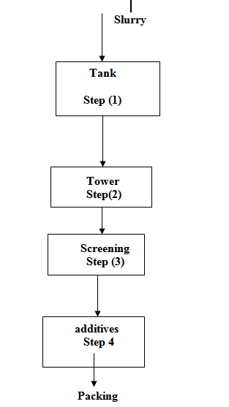

Slide 37
Additives
A builder softens water enabling the surfactant to perform with greater efficiency.
A surfactant lowers the surface tension of the washing water enabling it to wet a surface and more readily lessen and remove soils.
A bleaching agent destroys organic soils by oxidation and improve whiteness.
Enzymes which break down proteins, fates and starches for ease of removal

Slide 38
