Slide 1

Organic Chemistry
CHE 110
HIGHER TECHNOLOGICAL INSTITUTE - 10th of Ramadan City
CHEMICAL ENGINEERING DEPARTMENT

Slide 2
Organic chemistry I CHE110
Course aims for the theoretical part:
Have extensive knowledge on various classes of aliphatic compounds, their
nomenclature, their synthesis, reactions and stereochemistry
Know the chemical and physical properties of various classes of aliphatics: such as Alkanes, Alkenes, Alkynes, Alkyl halides, Alcohols, Aldehydes, Ketones, Carboxylic acids, Esters, Amides
Master various types of substitution, addition, and elimination reactions
and be able to apply them for synthesis of vast amount of aliphatic compounds
Understand various types of isomerism (Structural and Stereo), how
to synthesize specific isomer.

Slide 3
The objectives of the first handout are to know:
  General Chemistry Review (Introduction)
Definition of hydrocarbons, Alkanes and its different presentation
  Types of carbon and hydrogen atoms.
  Alkyl groups, Isomerism; constitution, and skeletal isomers.
  IUPAC nomenclature rules of unbranched & branched alkanes
  All special cases related to naming
  How to solve exercises on naming and drawing of alkanes.
.

Slide 4
Several scientific terminologies such as Staggered, Eclipsed, and Conformers.
The conformational analysis of alkanes using Newman, perspective, and Sawhorse projections
Reactions of Alkanes; Oxidation, and heat of combustion versus stability.
Alkenes; structure, Nomenclature, IUPAC rules, and alkenyl groups.
Alkenes; structure, Nomenclature, IUPAC rules, and alkenyl groups.

Slide 5
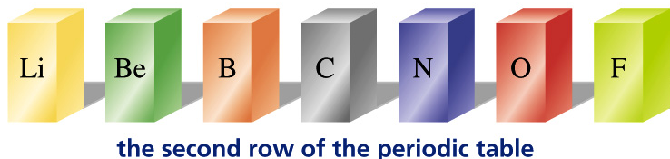
(Review)
General Chemistry
Introduction
Learning organic chemistry is a natural prerequisite for entry into many medical, dental, pharmacy, and
graduate schools.
Organic compounds are compounds containing Carbon.
Carbon neither readily gives up nor accepts electrons.
Carbon shares electrons with other carbon atoms as well as with several different kinds of atoms.

Slide 6
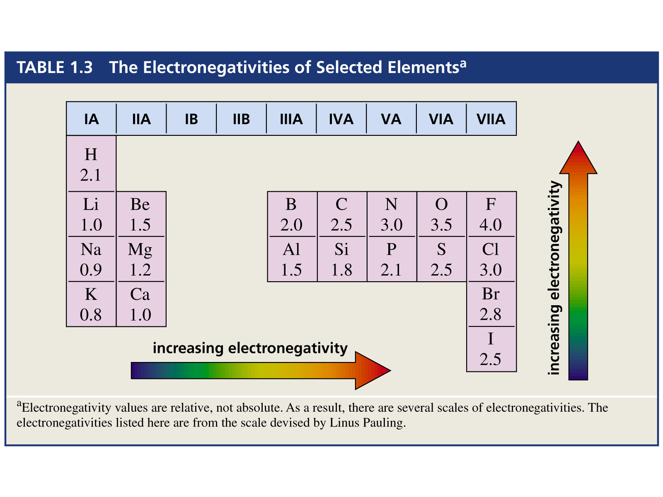
Covalent Compounds
Equal sharing of electrons i.e. between those having the same electronegativity: nonpolar covalent bond
Sharing of electrons between atoms of different
electronegativities: polar covalent bond (e.g., HF)
Electronegativity of carbon is almost the same as that of hydrogen

Slide 7

Sigma Bond (covalent)
Covalent bonds
Without removing electrons from an atom, orbitals can interact to form a bond where both binding partners contribute. The new bond is located between the two atoms.
Two electron clouds overlap results in increasing electron density between nuclei

Slide 8
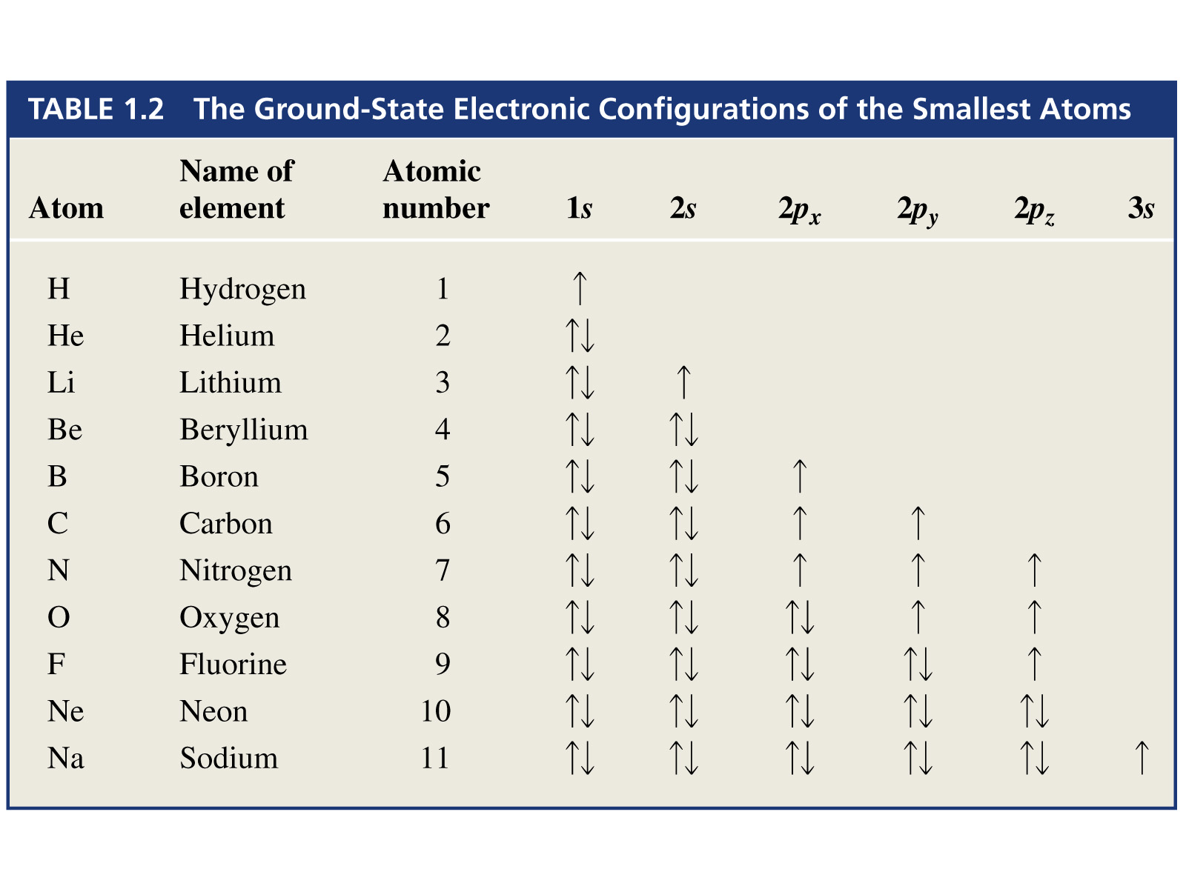
i.e
Electron Configuration of C: 1s² 2s² 2p²
valence electrons
Atomic orbitals of valence electrons (s and p may hybridize (mix) to yield three new types of hybridized orbitals depending upon the molecular structure; sp³, sp², & sp
Hybrid orbitals try to maximize distance between orbital loops, this tendency determines spatial arrangements
(VSEPR – Valence Shell Electron Pair Repulsion)

Slide 9
1 Hydrocarbons
C_{n}H_{2n+2}
1.1 Alkanes
1.1.1 Structure
Definitions:
A hydrocarbon compound is composed of
carbon and hydrogen only.
Saturated compound is made of:
single bonds only (no double or triple bonds).
An alkane is a saturated hydrocarbon. (sigma bonds)
Sp³.

Slide 10
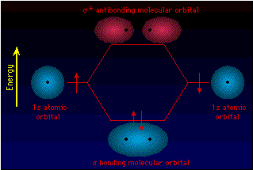
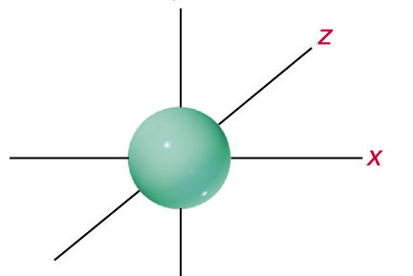
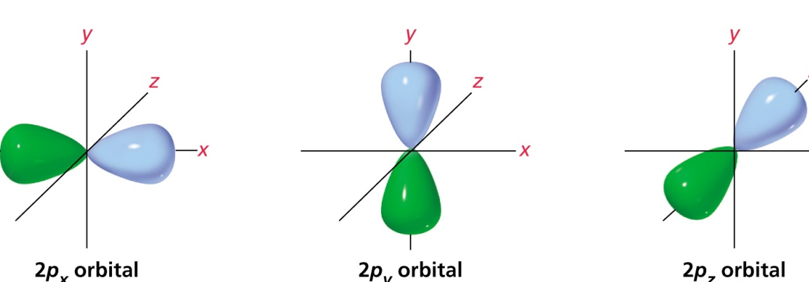
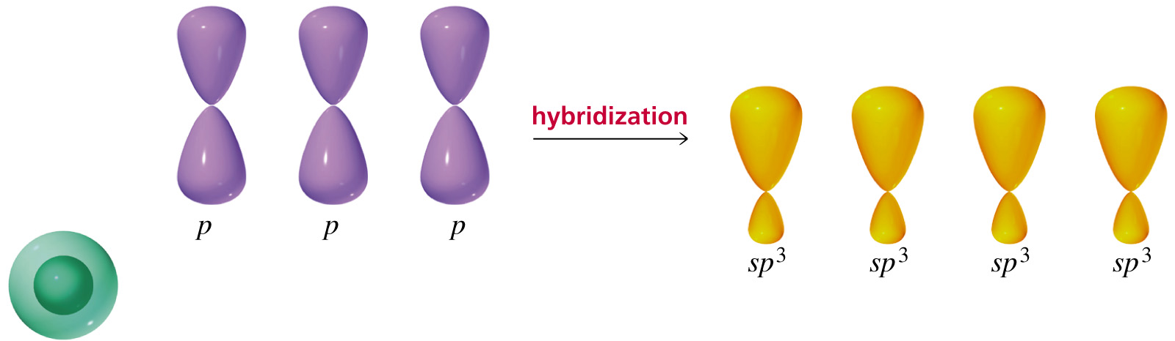
All bonds are: singles, of same length, shape, and make equal angles 109.5 º.
promotion
hybridization
→
→
2s² 2p²
2s¹ 2p³
4 sp³ hybridized orbitals
2s1
2p³

Slide 11
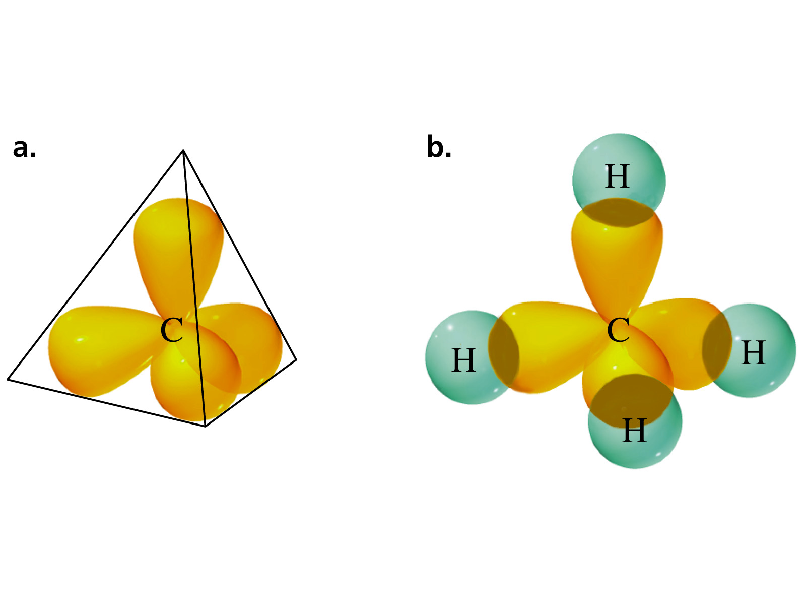
The number of hybridized orbitals determine the bond angles
Electron pairs spread themselves into space as far from
each other as possible
Tetrahedral bond angle: 109.5°

Slide 12
Sigma bond: one in which the atomic orbitals are aligned along the internuclear axis.
Pi bond: one in which the atomic orbitals are perpendicular to the internuclear axis.

Slide 13
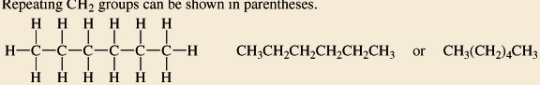
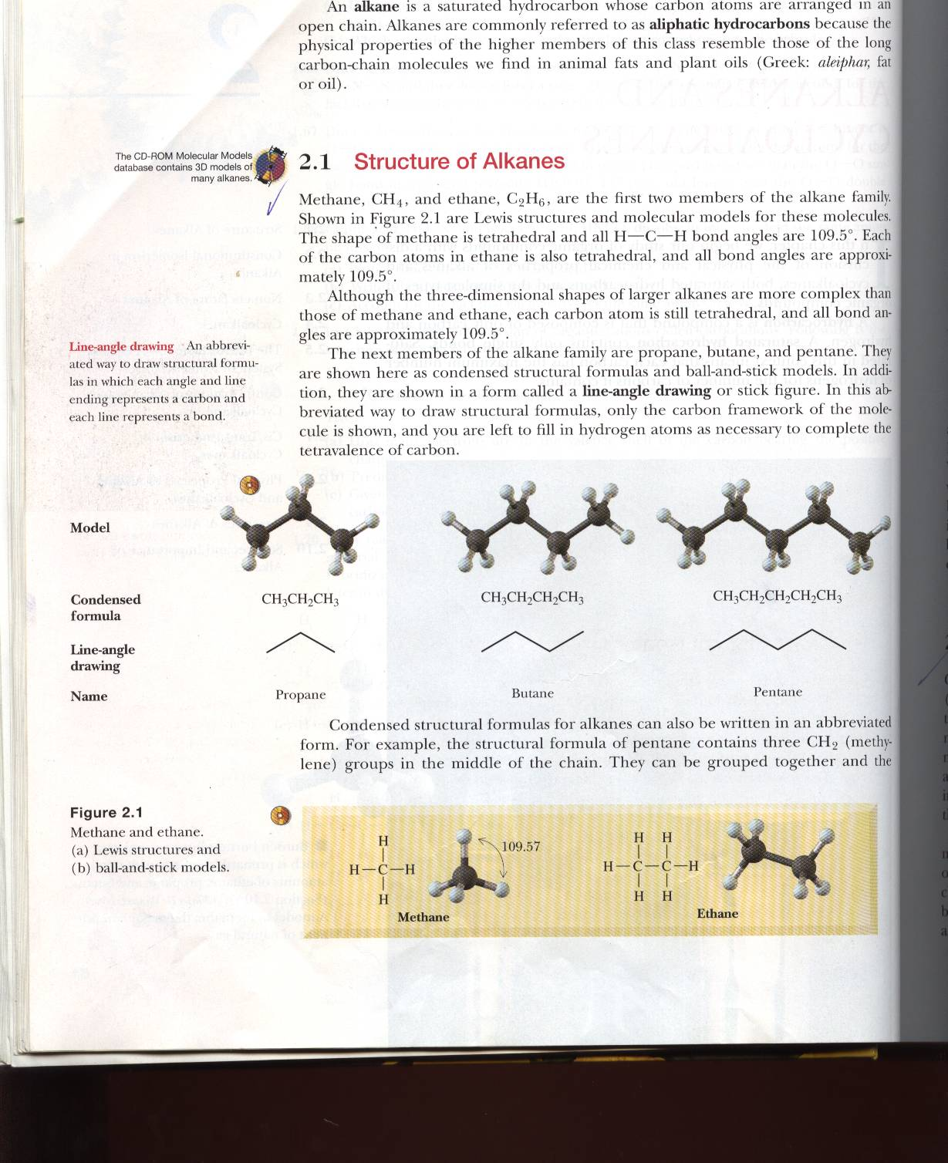
Alkanes could be presented in different ways:
Lewis
Drawing
Condensed
Drawing
CH₄
CH₃CH₃
Lewis
Drawing
Condensed
Drawing

Slide 14
1.1.2
1°
2°
4°
3°
(1°)
Attached to one C atom only
(2°)
Attached to two C atoms
(3°)
Attached to three C atoms
(4°)
Attached to four C atoms

Slide 15
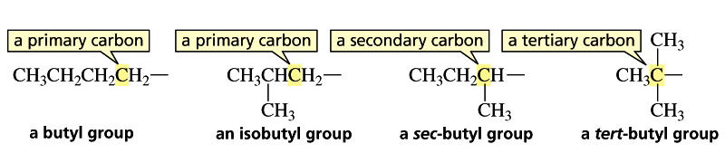
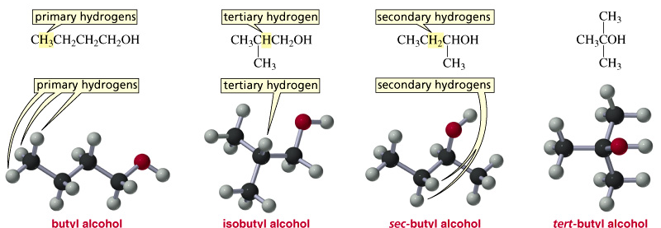
Some Examples of Different Kinds of Carbons and Hydrogens

Slide 16
Prefixes Used in the IUPAC System to show the Presence of
1 to 20 Carbon Atoms
IUPAC :International Union of Pure and Applied Chemistry.

Slide 17
1.1.3 Alkyl groups:
Alkyl group is derived by removing a hydrogen from an alkane.
It is represented by the symbol R-
Nomenclature of Unbranched Alkyl Groups
Alkanes have names that end in -ane
Alkyl groups have names that end in -yl
When alkane is unbranched and the missing hydrogen is terminal, the names are straightforward
Examples:
CH₄(Methane)
CH₃- (Methyl group)
CH₃CH₂CH₂CH₃ (Butane)
CH₃CH₂CH₂CH₂- (Butyl group)

Slide 18
Nomenclature of Branched Alkyl Groups (approved by IUPAC)

Slide 19
1.1.4 Unbranched and Branched Alkanes
Some definitions
Isomers: Two or more different compounds having the same chemical formula.
Molecular formula: Formula that gives the number of each
kind of atom in a molecule. e.g. C₂H₆
Constitutional isomers have the same molecular formula, but their atoms are linked differently.
Skeletal Isomers: A type of Structural Isomers. They have the
same molecular formula however, different carbon skeletons e.g.
Both skeletal isomers have the molecular formula C₅H₁₂

Slide 20
CH₃CH₂CH₂CH₃
Both are named Skeletal isomers of C₄H₁₀ . They differ
in physical properties such as B.P as well as chemical
behavior.
e.g. Skeletal Isomers of the Molecular Formula C₅H₁₂

Slide 21
Problem: Name the following compound:

Slide 22
1.1.5 IUPAC Nomenclature Rules of Branched Chain Alkanes
Longest continuous chain (nonane), is branched with 3 c atom-branch (substituent), propyl.

Slide 23
Rule # 3: Di-, Tri-, and Tetra-Rule
pentane
2-methyl
1 2 3 4 5
3-methyl
4-methyl

Slide 24
Rule # 4: Alphabetical Rule
List substituents (groups) in alphabetical order. Discard prefixes Di-,Tri-, Tetra-, sec-, and tert- but not neo, iso, or cyclo.
6 5 4 3 2 1
1 2 3 4 5 6
hexane
3-methyl
3-ethyl
nonane
2-methyl
1 2 3 4 5 7 8 9
4-isopropyl
6
6-tert-butyl

Slide 25
heptane
7 6 5 4 3 2 1
2-methyl
3-methyl
4-propyl
5-methyl

Slide 26
heptane
1 2 3 4 5 6 7
2-methyl
2-methyl
7 6 5 4 3 2 1
4-methyl
3-methyl
5-methyl
4-methyl
6-methyl
6-methyl

Slide 27
nonane
4- isopropyl
6-methyl
9 8 7 6 5 4 3 2 1
And not
Important hints:
Same as:
CH₃CH₂CH₂CH₂CH₂CH₃
Same as:

Slide 28
Isopropyl, sec-butyl, tert-butyl as well as other branched substituents could be named as systematic substituent names.
Systematic substituent names are obtained by numbering the alkyl substituent starting at the carbon that is attached to the parent hydrocarbon.
This means that this carbon is always given number 1. In a compound
such as 4-(1-methylethyl) octane, the substituent name is in parentheses; the
number inside the parentheses indicates a position on the substituent, whereas
the number outside the parentheses indicates a position on the parent
hydrocarbon. For example:
decane
4-propyl
6-
(1,2-dimethylpropyl)
6-(1,2-dimethylpropyl)
-4-propyldecane

Slide 29
Using IUPAC system, name each of the following compounds
CH3(CH2)2C(CH2CH3)2CH(CH3)CH(CH2CH2CH3)2
Draw the structure and give the IUPAC name of a compound with a molecular formula C₅H₁₂ that has:
Only primary and secondary hydrogen atoms
Only primary hydrogen atoms
One tertiary hydrogen atom
Two secondary hydrogen atoms

Slide 30
The objectives of the 2nd Handout are to know about:
Alkenes; structure, Nomenclature, IUPAC rules, and alkenyl groups Geometric Isomerism in Alkenes; cis-,trans, E, & Z isomers
The physical properties of alkenes.
Relative stabilities of conjugated and isolated diens.
The nomenclature rules of Alkynes.
30

Slide 31
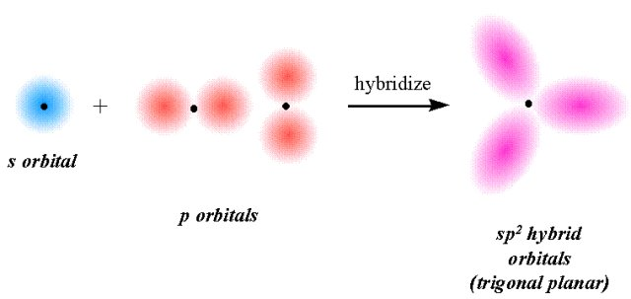
1.2 Alkenes CnH2n (Olefines)
Many of the flavors, hormones, and insect pheromones belong to the alkene family.
1.2.1 Structure:
Missing 2H atoms i.e. unsaturated i.e. 2 carbon atoms joined together by a double bond one of which is σ and the other is pi
Shape of molecule is trigonal planar i.e.
all atoms are in the same plane
all angles are almost identical
[Review ]To form an alkene, atomic orbitals of carbon combine (hybridize) to create 3 identical orbitals.
2

Slide 32
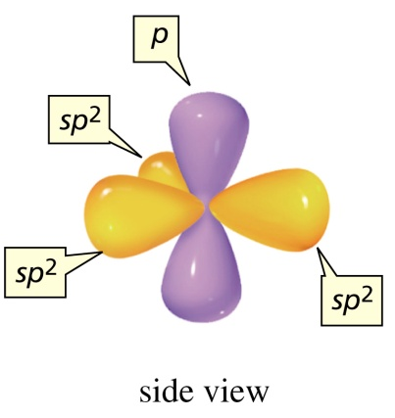

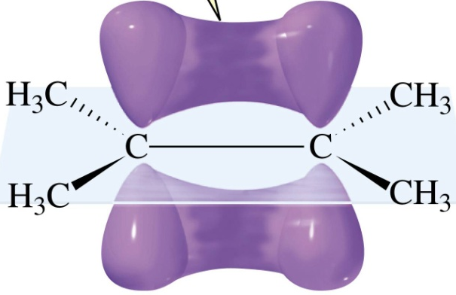

An sp²-Hybridized Carbon
i.e.
σ
σ
π
Molecular orbital
of ethene

Slide 33
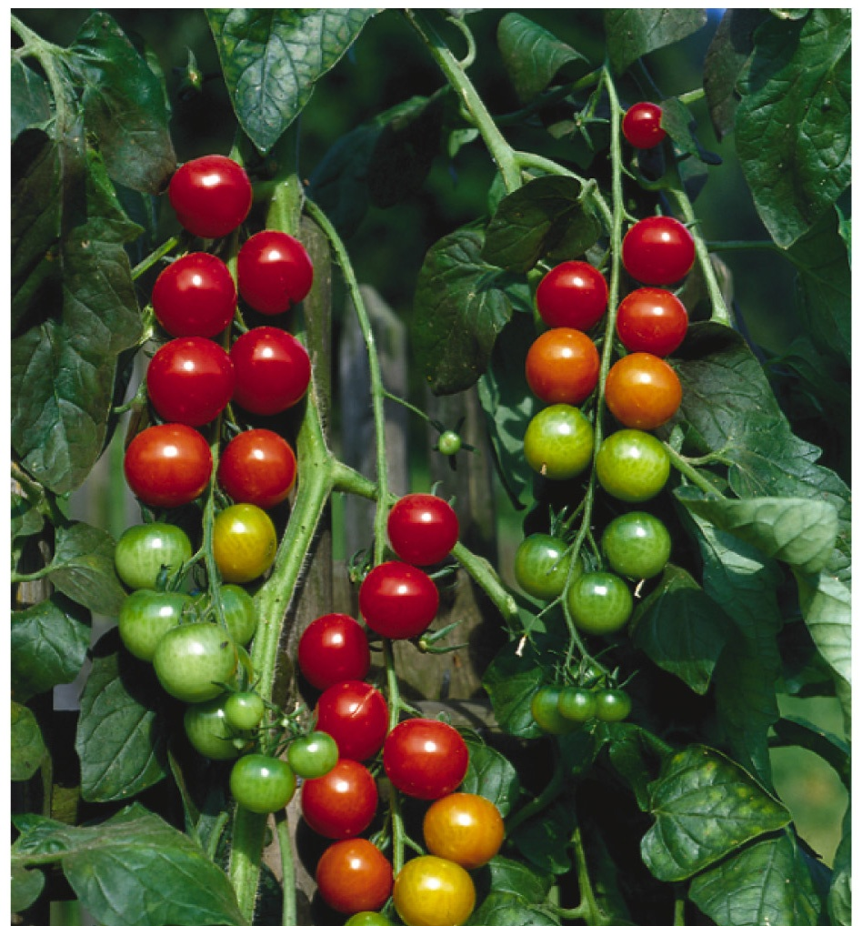
Ethene is the hormone that causes tomatoes to ripen.

Slide 34
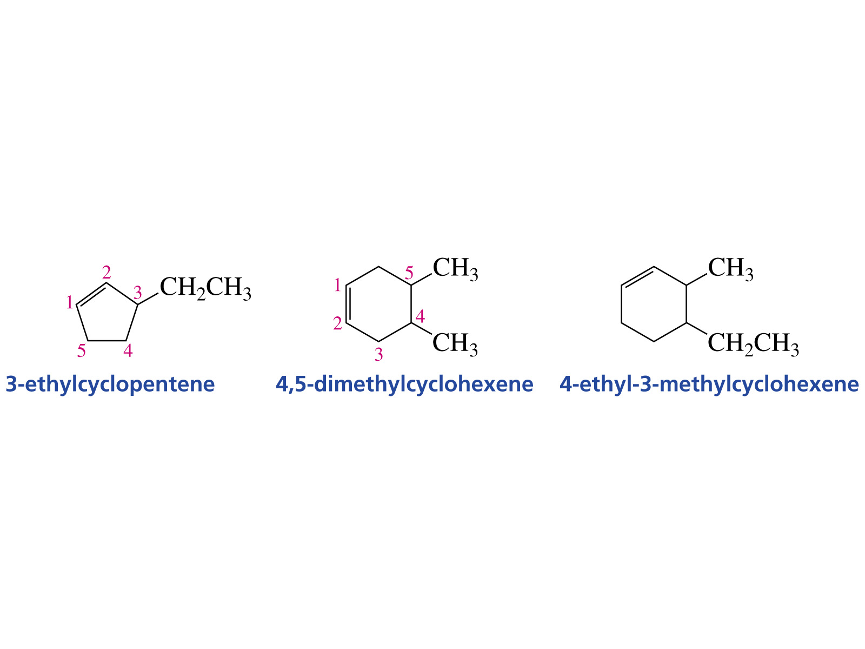
IUPAC Rules: Similar to alkanes except:
2) Longest chain containing double bond
The 9-carbon chain is not the base as it does not include the double bond.
Also the base is: 1-octene (not 7-octene)
As a result, No numbering of the functional group is needed in a cyclic alkene
Ethenyl (IUPAC) or vinyl (common name)
2-Propenyl (IUPAC) or allyl (common)
e.g.
Ethenyl chloride (IUPAC) or vinyl chloride (common)

Slide 35
1.2.4 Geometric Isomerism in Alkenes
is the condensed formula for 1,2-Dichloroethene
In fact this formula may represent two different compounds (isomers) that differ only in arrangement of atoms in space

Slide 36
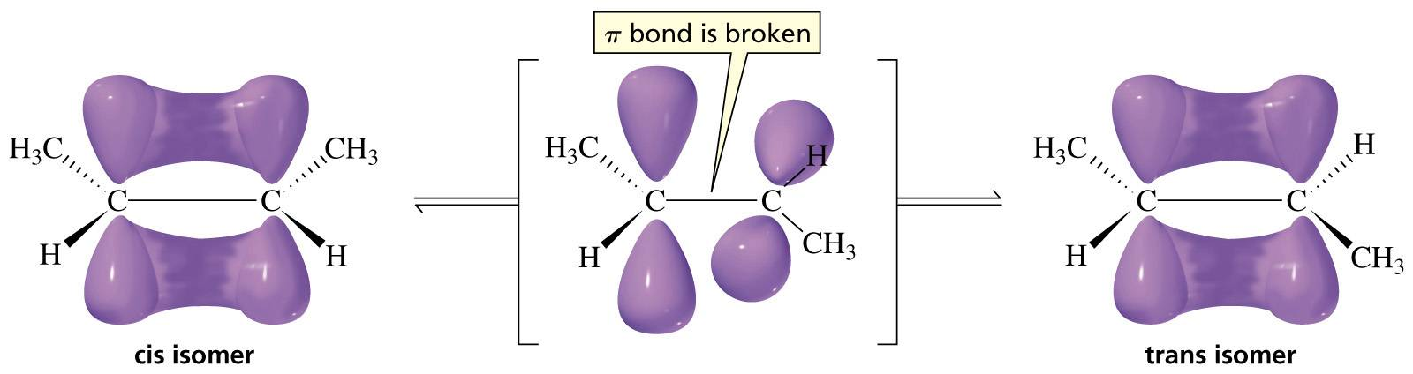
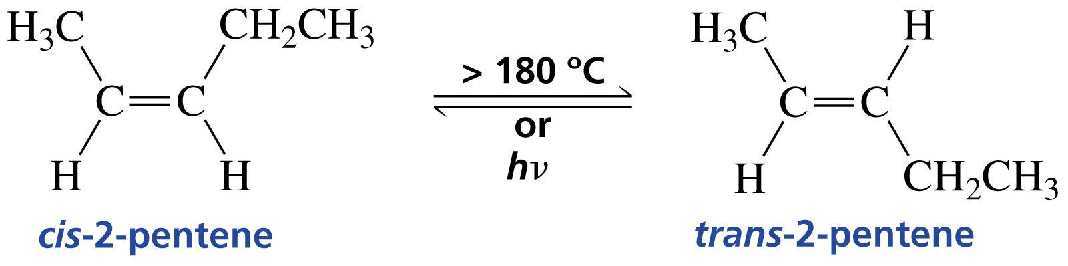

Slide 38
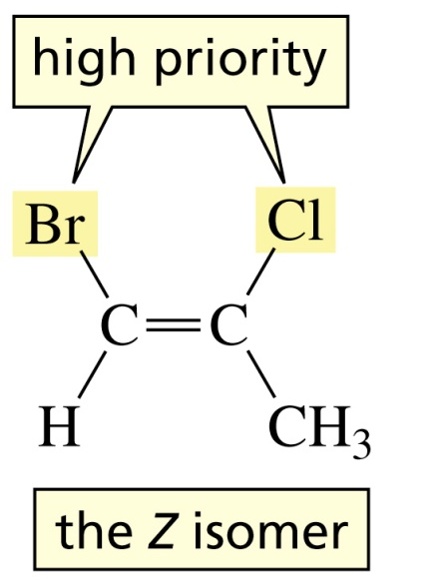

e.g.
(E) / (Z) system:
Rule 1: Examine the 2 atoms bonded directly to a specific sp² carbon & decide which has a higher priority (atomic number) .
If the two atoms of higher priority are on the same side of the double bond, the alkene is designated (Z) (from the German word Zusammen,
meaning together).
If the two atoms of higher priority are on opposite sides, the alkene is
designated (E) (from the German word Entgegen, meaning opposite)

Slide 39
Rule 2: If there is a tie, consider the atoms attached to the tie. e.g
3H ⇒ 3X1 = 3
2H,O ⇒ 2+8 = 10
If needed, go to the second atom…etc.
*
β
2H,C = 2X1 + 1X6 = 8
H,2C = 1X1 + 2X6 = 13
β
*
E/Z system could be applied to all types of alkenes i.e. it may replace cis/trans system. However, the latter does not always replace the former.
Z or E ?

Slide 40
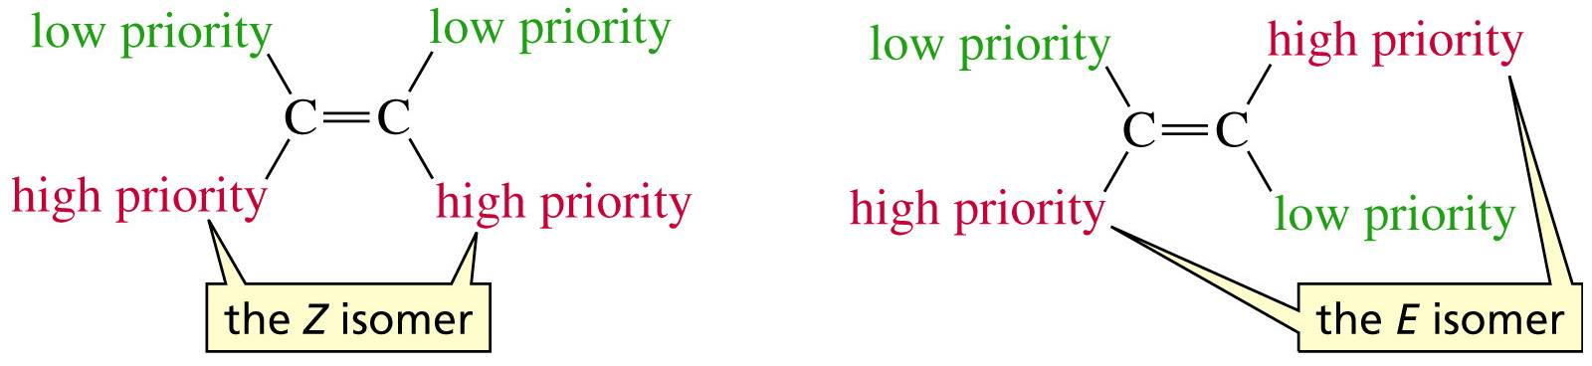
In Conclusion

Slide 41
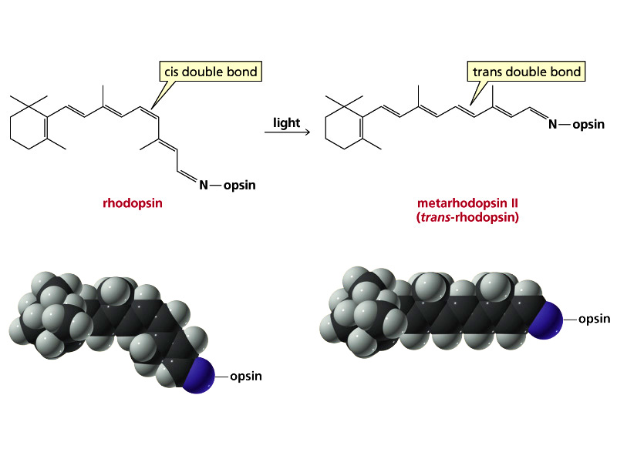

Slide 42
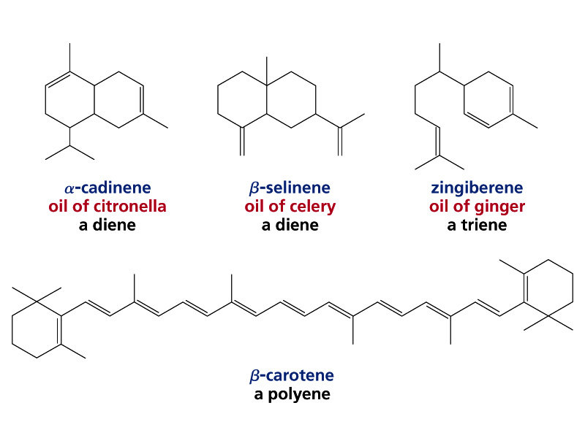
1.3.1 Structure
Two double bonds: diene,
Three double bonds: triene,
Four double bonds: tetraene,
Many double bonds: polyene

Slide 43
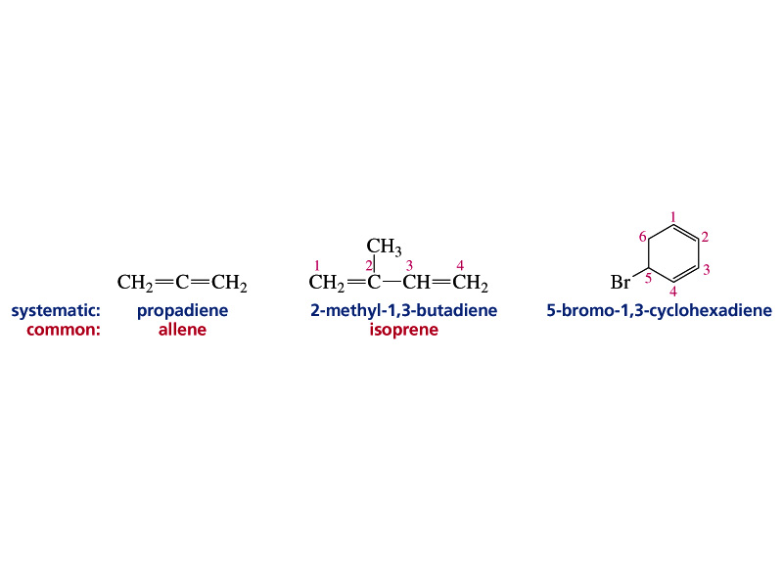
1.3.2 Nomenclature
Identify the longest continuous chain containing both double bonds.
Give the double bonds (not substituents) the lowest possible number.
3. Substituents are cited in alphabetical order.
5-Bromo-1,3-cyclohexadiene

Slide 44
2-Methyl-1,3-butadiene
1,3-cyclopentadiene
5
5-Propyl
1
4
The name is : 5-Propyl-1,3-cyclopentadiene
2
3

Slide 45
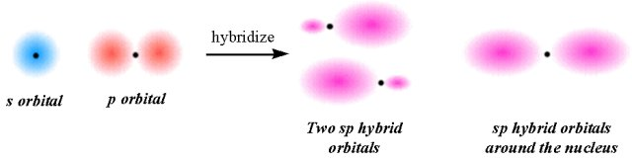
Alkynes (triple Bond)

Slide 46
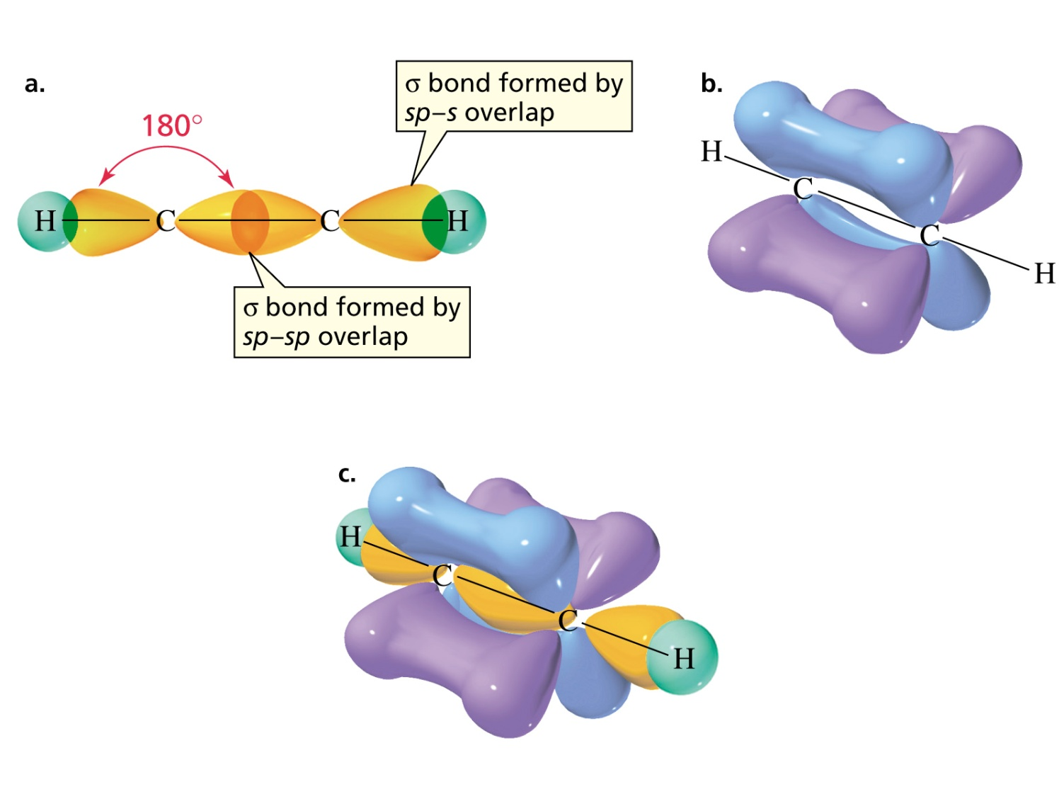
Bonding in Ethyne: A Triple Bond
A triple bond consists of one σ bond and two π bonds
Bond angle of the sp carbon: 180°

Slide 47
IUPAC Rules of branched alkynes: Similar to alkenes:
Lowest number for triple bond

Slide 48
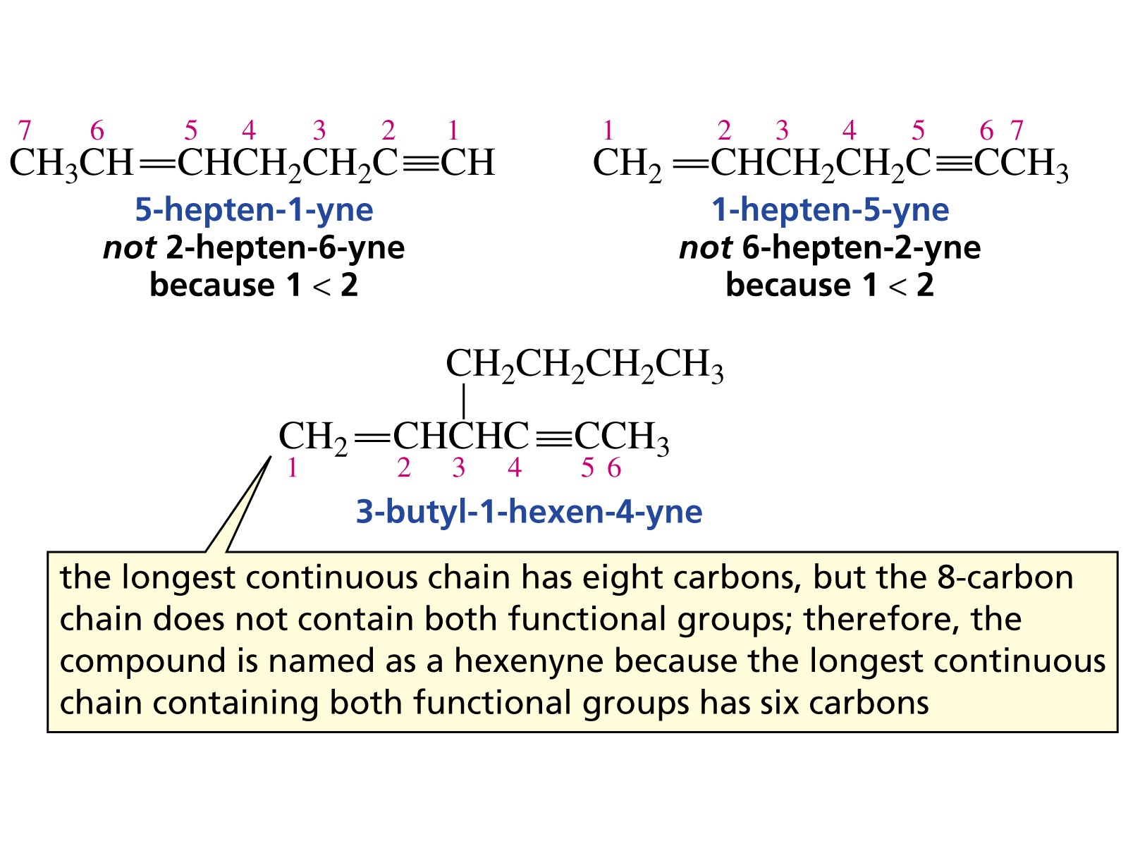
3) When both double and triple bond exist, give lowest possible numbers to the two functional groups and name it as alkenyne.

Slide 49
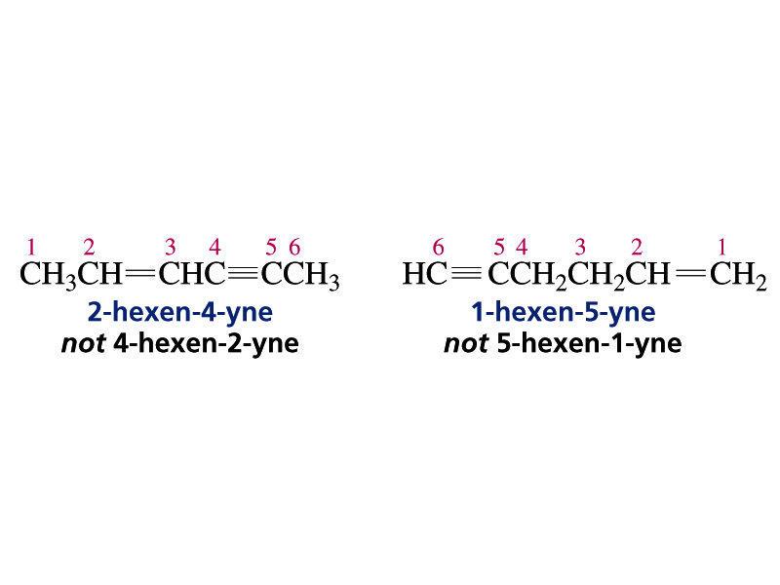
4) Longest chain must contain both functional groups.
5) If there is a tie, the double bond gets the lowest number

Slide 50
The objectives of the 3rd handout are to know about:
Functional groups: Definition, Most common functional groups neutral, acidic, and
basic functional groups, pKa values
Some Typical Reactions of Hydrocarbons
Radical Substitution Reactions, course, stability, and reactivity of radicals
Some free radical reaction mechanisms, Halogenation of alkanes, NBS alllylic substitution,
Free radical addition to alkenes (HBr / Peroxide addition), Radical polymerization of
alkenes
. Addition Reactions of Alkenes; Hydrohalogenation, Halogenation, Halohydrin
Formation , Alcohols from, Syn addition of hydrogen
Addition to alkynes
Addition to dienes
Relative stabilities of conjugated and isolated dienes.

Slide 51
1.5 Functional groups
1.5.1 Definition
It is the part of a molecule where most of its chemical
reactions occur. Alkanes pKa 50 do not have a functional
group. It is the part that effectively determines the
compound’s chemical and most of its physical properties.
1.5.2 Most common functional groups; examples
Alkene
pKa 40
Alkyne
pKa 25
Alcohol
CH3OH
pKa 16
Ether
Amino acid
pKa alpha COOH 2.4

Slide 52
Aldehyde
Carboxylic ester
Ketone
Carboxylic acid
Amine
Amide
52

Slide 53
1.6 Some Typical Reactions of Hydrocarbons
1.6.1 Substitution radical Reactions
In a substitution reaction one atom is replaced by another
Introduction
Addition reaction
1, 2-Dibromocyclohexane
however
substitution reaction
hν or Δ
i.e. energy
Bromocyclohexane

Slide 54


Mechanism: How a given reaction takes place?
In a chemical reaction some bonds are broken and others are formed via movement of electrons.
In explaining a mechanism, movement of a pair of electrons is
represented as follows:
Movement of one electron as follows:
hν
1.6.2 course, stability, and reactivity of radicals
Why?
The energy needed to break C ⎯ H bond depends on the type of C atom i.e. tert-(3°), sec-(2°), primary-(1°) or methyl.

Slide 55
The higher the amount of energy needed to break C ⎯ H bond, the less stability of the intermediate (free radical) hence, the greater the tendency of the intermediate to recombine with hydrogen i.e.
Highly unstable
More than 100 k cal/mol needed to break the C-H bond
98 k cal/mol
55
55

Slide 56
1.6.3 Halogenation of Alkanes
(monosubstitution only)
Mechanism:
(unstable, one ē short)

Slide 57
Some examples
1)
2)
The relative yield of products is dictated by the relative intermediates stabilities.
3)

Slide 58
1.6.4 Addition Reactions
General Equation
The addition to alkenes is electrophilic.
Mechanism.

Slide 59
However
Mechanism: (Electrophilic addition; H⁺ then Br⁻)
59

Slide 60
Problem: What is the major product when HCl reacts with 3-Methyl-2-Pentene?
1.6.4.2 Halogenation of Alkenes (Br₂ and Cl₂)
F₂ is too reactive)
I₂ is too slow
General Equation

Slide 61
This is an electrophilic anti addition reaction. Why? Bridge!
Mechanism: One chlorine (or Bromine) atom acts as the electrophile.
Bridge

Slide 62
example
cyclopentene
1.6.4.3 Halohydrin Formation (Addition of X and OH)
Mechanism is similar to 1.7.2.2 however, water molecule is the nucleophile rather than bromide ion

Slide 63
problems
1.6.4.4 Alcohols from Alkenes (Hydration i.e. addition of H₂O)
Types of Alcohols
(1°) alcohol [Ethyl alcohol; Ethanol]
(2°) alcohol [Isopropyl alcohol; Isopropanol]
(3°) alcohol [tert-Butyl alcohol; tert-Butanol]

Slide 64
Markovnikov’s Rule: on addition to double bonds, H is
attached to the carbon with the most hydrogens.
Negatively charged ion is considered a nucleophile. However, neutral H₂O molecule (or ROH) may react as a nucleophile also using lone pair’s electrons of oxygen atom.
Addition of X₂ or X & OH: anti-addition (trans product).
Acidic water addition of H, OH follows Mark.Rule (with possible rearrangement ).(hydride or methyl shift)
Oxymercuration reaction is anti addition of H, OH that follows Mark.Rule (However, no rearrangement occurs).
Hydroboration Method
For the preparation of all types of alcohols 1°, 2°, 3°
Syn addition i.e. both H and OH are added to the same face of double bond.
64
- Anti-Markovnikov’s addition
-NO possible rearrangement.

Slide 65
However
(2°) alcohol
also
(3°) alcohol

Slide 66
(Review)
(2°) alcohol
(3°) alcohol
Intermediates may rearrange for more stability by moving a hydride or methyl group. The move should be 1,2 shift ONLY.
66

Slide 67
Hydrohalogenation of Alkynes
Addition of water to Alkynes : Tautomerism
i.e. the product is a mixture of the enol and keto forms.
Tautomer: Isomeric equilibrium of 2 structures that differ in the arrangement of atoms.
The acidic water method is used in making a ketone from
an alkyne with the same # of C atoms.

Slide 68
Addition to Dienes (Electrophilic Addition)
Why?
Mechanism (as in 1.7.2.1)

Slide 69
1.6.12 Reactions of Acetylide Anions
A method to increase the chain length of an alkyne.
How to make acetylide ion (anion) ? It is similar to
Na + HO⎯H → ¹/₂ H₂ + NaOH
Acetylene reacts with Na as follows:
+
Na

Slide 70
Aldehydes and Ketones

Slide 71
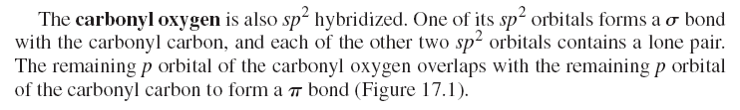
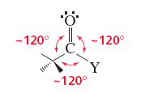
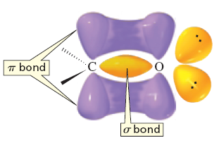
3 Aldehydes and Ketones (Alkanal & Alkanone)
3.1 Carbonyl group: structure, reactivity and molecular orbital model, polarity and polarization
Carbonyl group
p-Orbital Picture
Resonance Picture

Slide 72
Typical methods of the synthesis of Aldehydes and Ketones (Review)
Oxidation of alcohols
Secondary alcohols can be oxidized to ketones
OR KMnO4
Primary alcohols can be oxidized to aldehydes (absence of water!)
Ozonolysis of alkenes gives aldehydes or ketones
Hydration of terminal alkynes gives methyl ketones.

Slide 73
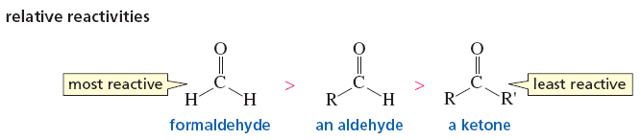
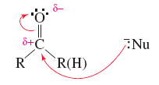
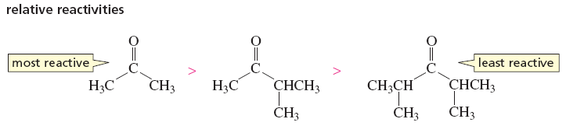
The preparation of alcohols from aldehydes or ketones with the same number and arrangement of carbon atoms.
3.2 General array of reactivities
Generally speaking, aldehydes are less stable than ketones hence, aldehydes are more
reactive. Among others, the steric factors contribute to the greater reactivity of an aldehyde

Slide 74
3.3 Nomenclature and trivial names of aldehydes and ketones
Nomenclature:
1) Aldehydes (alkanal)
Give #1 to
Formula IUPAC Common
Methanal
Formaldehyde
Ethanal
Acetaldehyde
Propanal
Propanaldehyde
3-Chloropropanal
2) Ketones (alkanone)
give
the lowest #
Formula IUPAC Common
Propanone
Acetone
Butanone
Methyl ethyl ketone
Alkanedione
2, 3-Pentanedione
2, 4-Pentanedione

Slide 75
1, 4-Cyclohexanedione
2, 3, 7-Trimethyl-5-decanone
(Alkenone,CO lowest #) 4-Penten-2-one
3-Pentanone
2-Pentanone

Slide 76
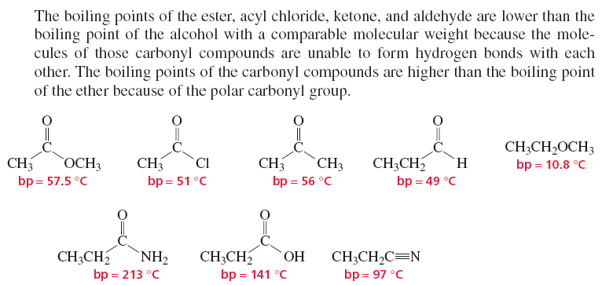

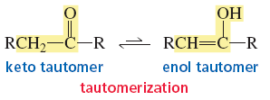
3.4 Physichochemical properties
Carbonyl group
They are strongly polar compounds hence, their B.P. are higher than corresponding alkanes and ethers. However, due to the absence of hydrogen bonding, B.P. of aldehydes and ketones are lower than corresponding alcohols and carboxylic acid.
3.5 Enolisation (Tautemerization)

Slide 77
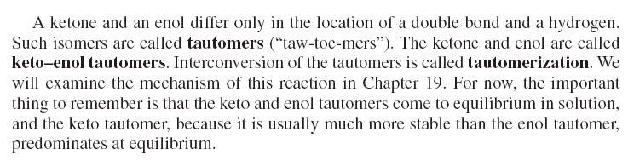
3.6 Some typical reactions of aldehydes and ketones:
Nucleophilic Additions Reactions

Slide 78
3.6.2
Hemiacetals and Hemiketals
Under anhydrous conditions, dissolving an aldehyde in an alcohol causes the establishment of an equilibrium between the two and a new compound called “hemiacetal”.
The essential structure features of a hemiacetal are an –OH and –OR
groups attached to the same carbon atom (and since this carbon
atom came from an aldehyde, this carbon also has one hydrogen atom
attached to it).
very high
concentration
Most open-chain hemiacetals are not sufficiently stable to isolate. However,
cyclic ones with 5 or 6 membered rings are usually much more stable.

Slide 79
Most simple sugars exist primarily in a cyclic hemiacetal form. Glucose is an example.
Hemiketals
Ketones undergo similar reactions when are dissolved in an alcohol producing also unstable products in open-chain compounds “hemiketals”
Conversion of Aldehydes / Ketones to Acetals / Ketals through Hemiacetals / Hemiketals intermediates
It should be emphasized that acid catalysis is required to make
an acetal OR a ketal.
Why? A: the mechanism
Mechanism of hemiketal formation from ketone is similar to the formation of hemiacetal from an aldehyde.

Slide 80
Mechanism
1) Formation of Hemiacetals/Hemiketals
All steps are reversible
2) Hemiacetals /Hemiketals to Acetals/Ketals
As expected, excess ROH and /or removal of water shifts equilibrium to
product. On the other hand addition of water converts the product back
into the carbonyl group.

Slide 81
Mechanism

