Slide 1
MCQ Engineering Chemistry
Chemical Engineering Department
Made by: Eng. Mennatullah Mahmoud
Chapter 4

Slide 2
Summary

Slide 3
Summary

Slide 4
Summary

Slide 5
Summary

Slide 6
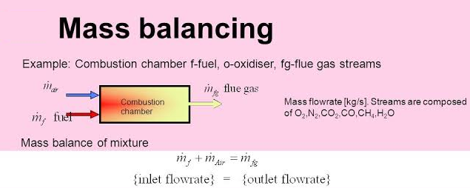
Summary

Slide 7
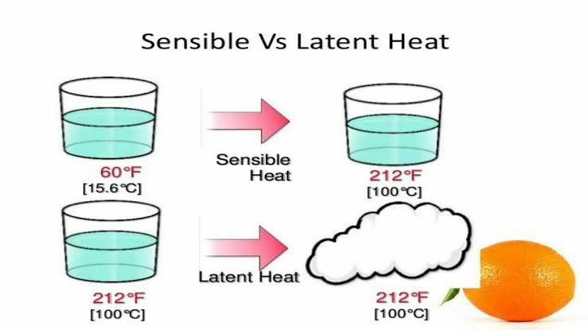
Summary

Slide 8
Summary

Slide 9
Summary

Slide 10
Summary

Slide 11
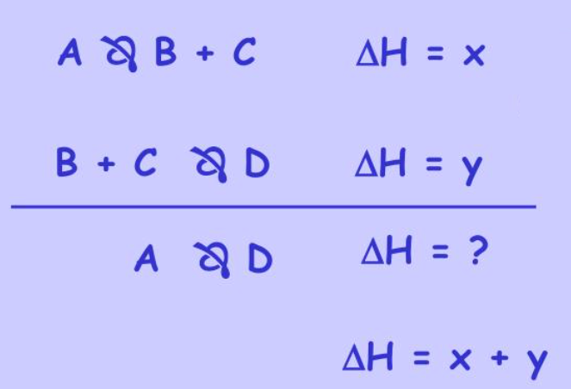

Slide 12
Summary

Slide 13
.
Summary

Slide 14
Choose the correct answer:
1- For exothermic reactions, what is the heat of reaction?
a) Positive
b) Negative
c) Zero
d) Cannot Say
Answer: b
Explanation: In exothermic reactions, heat leaves the system, so the heat of reaction is negative.

Slide 15
Choose the correct answer:
2- Enthalpy of reactants is 15 J/Kg and enthalpy of products is 40 J/Kg, what is the heat of reaction?
a) -10 J/Kg
b) 10 J/Kg
c) -25 J/Kg
d) 25 J/Kg
Answer: d
Explanation: Heat of reaction = 40 – 15 = 25 J/Kg.

Slide 16
Choose the correct answer:
3- Heat of formations of A, B, C, and D, are 5 J, 10 J, 15 J, and 20 J respectively, what is the heat of reaction A + 4B -> 3C + D?
a) 10 J
b) 20 J
c) 35 J
d) 45 J
Answer: b
Explanation: Heat of reaction = 20 + 3*15 – 4*10 – 5 = 20 J.

Slide 17
Choose the correct answer:
4- In the reaction C + O₂ -> CO₂, if the heat liberated is 10 J, what is the heat of formation of CO2?
a) -10 J
b) 10 J
c) 0
Answer: a
Explanation: Heat of formation = -10 J.

Slide 18
Choose the correct answer:
5- What is the heat of reaction for CH₄ + 2O₂ -> CO₂ + 2H₂O, if heat of formation of CH₄, O₂, CO₂ and H₂O are 10 J, 5 J, 6 J, and 12 J respectively?
a) -10 J
b) 10 J
c) -20 J
d) 20 J
Answer: b
Explanation: Heat of reaction = 2*12 + 6 – 2*5 – 10 = 10 J.

Slide 19
Choose the correct answer:
6- H₂(g) + Cl₂(g) ==> 2HCl(g)
but think of it as: H–H + Cl–Cl ==> H–Cl + H–Cl (displayed formula style)
(where – represents the chemical bonds to be broken or formed)---- the bond energies in kJ/mol are: H–H = 436; Cl–Cl = 242; H–Cl = 431. Determine the enthalpy of reaction:
a) -184 kJ
b) 184 KJ
c) 678 KJ
d) 862KJ
Answer: a
Explanation: 436+242-(2*431)=-184
So the energy change is written as -184 kJ/mol

Slide 20
Choose the correct answer:
7-Determine the enthalpy of reaction for the following:
N₂(g) + 3H₂(g) ==> 2NH₃(g) bond energies in kJ/mol: N-N is 944, H–H is 436 and N–H is 388
a) 76 kJ/mol
b) -76 kJ/mol
c) 67 kJ/mol
d) - 67 kJ/mol
Answer: b
944+(3*436)-(2*3*388)=-76
Therefore energy change = -76 kJ/mol equation

Slide 21
Choose the correct answer:
8- wC₃H₆O₃ + xO₂ –> yCO₂ + zH₂O, what is the value of w + x + y + z?
a) 3
b) 6
c) 10
d) 14
Answer: : c
Explanation: The balanced chemical reaction is: C3H6O3 + 3O2 –> 3CO2 + 3H2O, => w + x + y + z = 10.

Slide 22
Choose the correct answer:
9- Solution-1 at the rate F combines with solution-2 at the rate D, their combination gives the product at the rate P, what is the equation of material balance?
a) F + D = P
b) F – P = D
c) D – F = P
d) None of the mentioned
Answer: a
Explanation: The general equation of material balance is F + D = P.

Slide 23
Choose the correct answer:
10- Solution-1 containing 30% sulfuric acid flowing at the rate 10 Kg/min combines with Solution-2 containing 20% sulfuric acid flowing at the rate 5 Kg/min, what is the percentage of sulfuric acid in the product?
a) 26.67%
b) 30%
c) 15%
d) 40%
Answer: b
Explanation: Equation of material balance, 0.3(10) + 0.2(5) = x(15), => x = 0.2667, => Percentage of sulfuric acid in the product = 26.67%.

Slide 24
Choose the correct answer:
11- Solution-1 containing 10% nitric acid flowing at the rate 10 Kg/min combines with Solution-2 containing 40% nitric acid flowing at the rate 5 Kg/min, if their product contains 30% nitric acid, what is the flow rate of product?
a) 15 Kg/min
b) 20 Kg/min
c) 30 Kg/min
d) 40 Kg/min
Answer :a
10+5=15 Kg/min

Slide 25
Choose the correct answer:
12-How much energy would it take to boil 36.0 g of water at 100 oC? Hvap = 40.7 KJ/mol
81.4 KJ
1470 KJ
1.13 KJ
0.0123 KJ
None of these are correct.
Answer : a
Q=36/18*40.7=81.4

Slide 26
Choose the correct answer:
13- CH₄ at the rate 10 mole/min is reacted with O₂ at the rate 10 mole/min, what is the rate of formation of CO₂ in the product?
a) 5 mole/min
b) 10 mole/min
c) 20 mole/min
d) 40 mole/min
ANSWER: a
Explanation: The balanced chemical reaction is: CH₄ + 2O₂ -> CO₂ + 2H₂O, this means O2 is the limiting reagent, => rate of formation of CO₂ = 10/2 = 5 mole/min.

Slide 27
Choose the correct answer:
14- In a steady-state reactive system, 5 molar CH₄ and 5 molar O₂ are supplied to the system, then what is the amount of CO₂ produced?
a) 2.5 molar
b) 5 molar
c) 7.5 molar
d) 10 molar
ANSWER: a
Explanation: The balanced chemical reaction of the system is
CH₄ +2 O₂ -> CO₂ + 2H₂O, => amount of CO₂ = 2.5 molar.

Slide 28
Choose the correct answer:
15- Calculate the enthalpy for the following reaction:
N₂(g)+2O₂(g) $→$ 2NO₂ (g) ΔH°=???kJ
Using the following two equations:
N₂(g)+O₂(g) $→$ 2NO(g) ΔH° = +180kJ
2NO₂ (g) $→$ 2NO(g)+O₂(g) ΔH° = +112kJ
a ) +68kJ/mol.
b ) - 68kJ/mol.
C) +80 kJ/mol.
ANSWER: a
Explanation: In order to solve this, we must reverse at least one equation and it turns out that the second one will require reversal. Here are both with the reversal to the second:
N₂(g)+O₂ (g) $→$ 2NO(g) ΔH° = +180kJ
2NO(g)+O₂(g) $→$ 2NO₂ (g) ΔH° = -112kJ
Notice that I have also changed the sign on the enthalpy from positive to negative.
Next, we add the two equations together and eliminate identical items. We also add the two enthalpies together.
N₂(g)+2O₂ (g) $→$ 2NO₂ (g) ΔH°= +68kJ

Slide 29
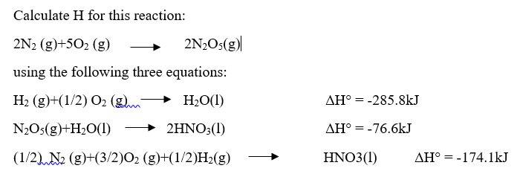
Choose the correct answer:
16-
a) +28.4kJ
b) – 28.4kJ
c) +38.4kJ
Answer : a.
Explanation:

Slide 30
Choose the correct answer:
17- Use the thermochemical equations shown below to determine the enthalpy for the reaction: C₂H₆O(l)+3O₂(g) $→$ 2CO₂(g)+3H₂O(l)
2C₂H₄O(l)+2H₂O(l) $→$ 2C₂H₆O(l)+O₂(g) ΔH°= +203.5kJ
2CO₂ (g)+2H₂O(l) $→$ C₂H₄O(l)+5/2O₂(g) ΔH°= +583.5kJ
a) – 685.25 kJ
b) – 685.25 kJ
c) – 865.25 kJ
d) + 865.25 kJ
Answer: a.
Explanation: : C₂H₆O(l)+3O₂(g) $→$ 2CO₂(g)+3H₂O(l)
C₂H₆O(l)+1/2O₂(g) $→$ C₂H₄O(l)+H₂O(l) ΔH°= [(203.5kJ) / (2)] [-1] = -101.75 kJ
C₂H₄O(l)+5/2O₂(g) $→$ 2CO₂ (g)+2H₂O(l) ΔH°= (+583.5kJ)(-1) = -583.5 kJ
C₂H₆O(l)+3O₂(g) $→$ 2CO₂(g)+3H₂O(l) ΔH°= -685.25 kJ
The answer has been obtained –685.25 kJ

Slide 31
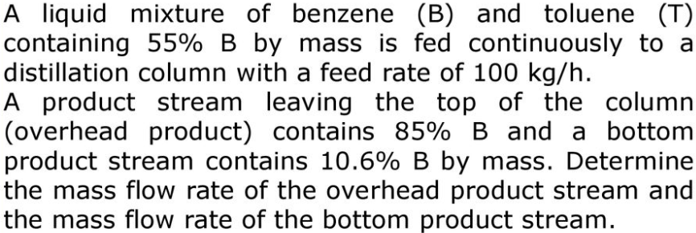
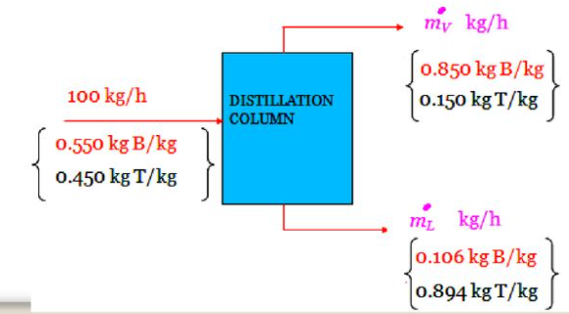
Choose the correct answer:
18-
a) $m_{v}^{°}=65 \frac{Kg}{h}, m_{L}^{°}$⁼ ³⁵ $kg/h$
b) $m_{v}^{°}=85.5 \frac{Kg}{h}, m_{L}^{°}$⁼ ¹$4.5 kg/h$
C) $m_{v}^{°}=59.7 \frac{Kg}{h}, m_{L}^{°}$^{= 40.4} $kg/h$
ANSWER: c

Slide 32
Choose the correct answer:
19- student must use 225 mL of hot water in a lab procedure. Calculate the amount of heat required to raise the temperature of 225 mL of water from20.0 $℃$to 100.0 $℃$.
a) 75.5 kJ
b) 80.5 kJ
C) 95.5 kJ
d. none of the above
ANSWER: a.
Explanation: since the density of water is 1.00 g /mL, the mass of 225 mL of water is 225 g for water is 4.184 J/g °C
q = mc$∆$T
q = (225 g)(4.184 J/g °C)(100.0°C - 20.0 °C) = 755312 J = 75.5 kJ

Slide 33
Choose the correct answer:
20- Calculate the specific heat capacity of a new alloy if a 15.4 g sample absorbs 393 J when it is heated from 0.0 $℃$ to 37.6 $℃$.
(a) c = 0.697 J/g $℃$ (b) c = 0.679 J/g $℃$ (c) c = 0.867 J/g $℃$ (d) c = 0.779 J/g $℃$
Answer: b
Explanation: m = 15.4 g
T = 37.6 $℃$q = 393 J
T = 0.0 $℃$
q = mc$∆$T
393 J = (15.4 g) (c) (37.6 $℃$ - 0.0 $℃$)
393 J = (579.04) x (c)
c = 0.679 J/g $℃$

Slide 34
Choose the correct answer:
21- If 80 kg of propanol C₃H₇OH are burnt in 20%excess air,. Calculate The mole fraction of Co2 produced.
a)0.38
b) 0.83
c)0.5
d)0.7
Answer: a

Slide 35
Choose the correct answer:
22- Calculate the final temperature when 100g iron at 80C is tossed into 53.5g of water at 25C where specific heat 0.452 J/g.C for iron and 4.186 J/gC for water.
34.2C
36C
43.2C
42.3C

Slide 36
Choose the correct answer:
23- How much heat is required to convert 422 g of liquid H₂O at 23.5 °C into steam at 150 °C? Cp water=4.18J/g.C , heat of vap = 40.67 Kj/mol , Cp for steam=1.84J/g.C
1127 Kj
130Kj
310Kj
148Kj

Slide 37
Thank you
Any questions?

